Slide 1
Web devalopment
Creat in web
Art by prasad
Notes:
Art by prasad

Slide 2
Web courses
HTML (hyper text markap language)
CSS (Cascading Style Sheets)
SQL (Structured Query Language)
JS (java script)

Slide 3


HTML(hyper text markup language)
HTML is the standard markup language for creating Web pages. What is HTML? HTML stands for Hyper Text Markup Language; HTML is the standard markup language

Slide 4
usess of html
Web Pages Development. Different websites we see on the internet regularly are in some form written in HTML code. ...
Navigating the Internet. ...
Responsive Designs. ...
Storage Function in the Browser. ...
Data Entry Support. ...
Creation of Web Documents. ...
Game Development. ...
Offline Web Applications

Slide 5

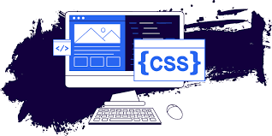
CSS (Cascading Style Sheets)
CSS is the language we use to style a Web page. What is CSS? CSS stands for Cascading Style Sheets; CSS describes how HTML elements are to be displayed on

Slide 6
usess of css
What is the main use of CSS?
CSS is used to define styles for your web pages, including the design, layout and variations in display for different devices and screen sizes.

Slide 7

SQL (Structured Query Language)
Structured Query Language is a domain-specific language used to manage data, especially in a relational database management system. It is particularly useful in handling structured data, i.e., data incorporating relations among entities and variables.

Slide 8

usess of SQL
You can use SQL statements to
store
update
remove,search,and retrieve information from the database. You can also use SQL to maintain and optimize database performance.

Slide 9
JS (java script)
JavaScript is the Programming Language for the Web.
JavaScript can update and change both HTML and CSS.
JavaScript can calculate, manipulate and validate data.

Slide 10

usess of java script
Web Development. JavaScript is a scripting language used to develop web pages. ...
Web Applications. Various JavaScript frameworks are used for developing and building robust web applications. ...
Presentations. ...
Server Applications. ...
Web Servers. ...
Games. ...
Art. ...
Smartwatch Apps.

Slide 11
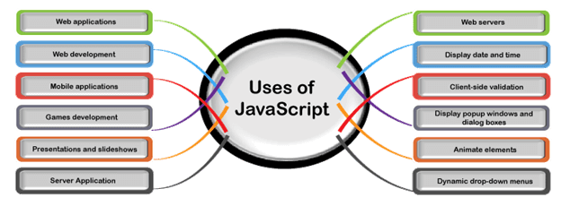
usess of java script

